Slide 1
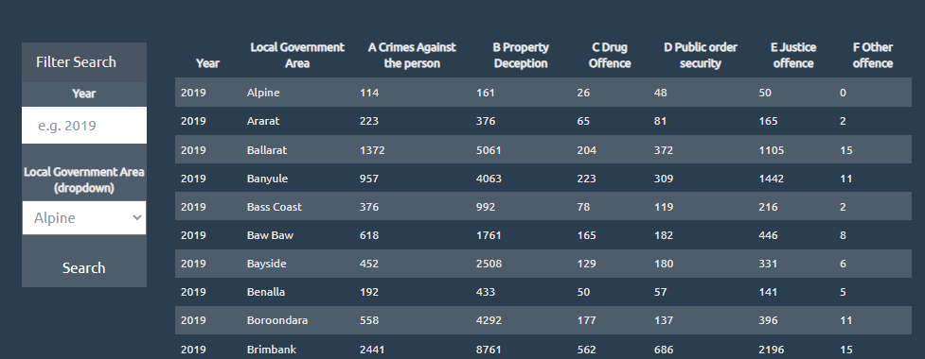
Offence Summary – Display and Filter
Using Offense Summary CSV (offence_summary_df.csv) from #Source
Year
Local Government Area
Offence types (A-F)
Displaying the summary data loaded from CSV, using Javascript, HTML and d3 (policedata.html, app.js)
Filtering by different fields (Local Government Area and Year)
Stretch goal: The LGA filter is populated from the data source as well

Slide 2
Offence Summary – Displaying Chart
With using Plotly, displaying bar chart representing the different offence types for a specific Local Government area

